Slide 1
Anatomical Priors in Convolutional Networks for Unsupervised Biomedical Segmentation
CVPR 2018
Speaker : Wang Shen

Slide 2
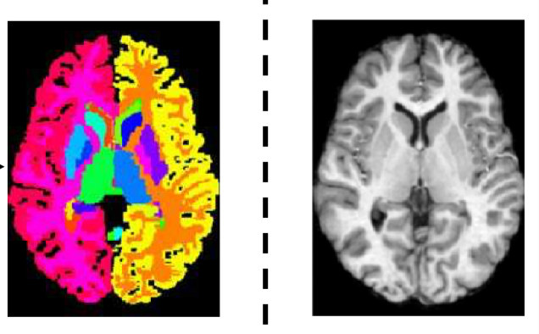
Introduction
Problem: Segment a biomedical image into anatomical regions of interest
Motivation: CNN-based segmentation models depend on amount of annotated data and lack anatomical knowledge.
Method: Generative probabilistic model
Contribution:
We demonstrate the method in an unsupervised biomedical image segmentation setting where paired annotations are not available.
ﬁrst zero-shot neural-network based segmentation of brain structures
anatomical segmentation
image
original
image

Slide 3
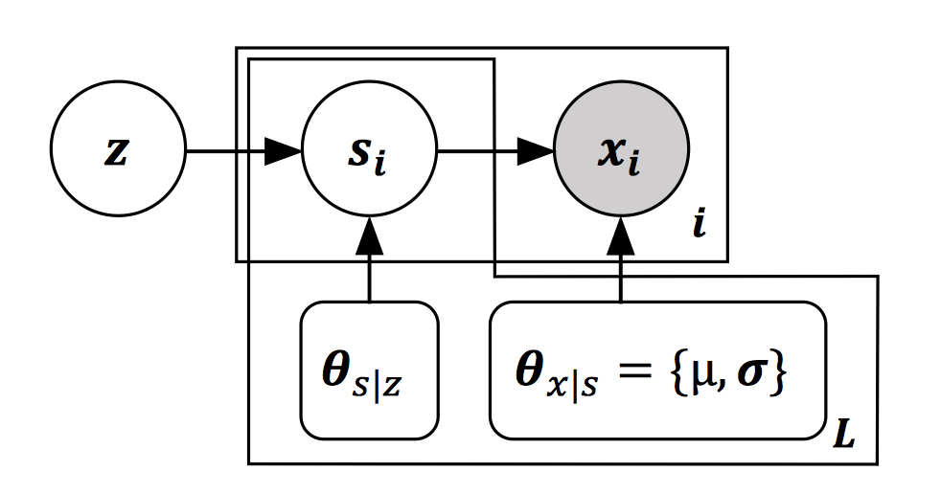
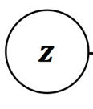

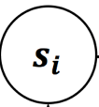
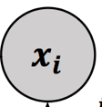
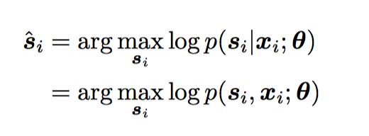

Model
Embedding
of shapes
Segmentation
map
Acquired
image
A graphical representation of our generative model.

Slide 4
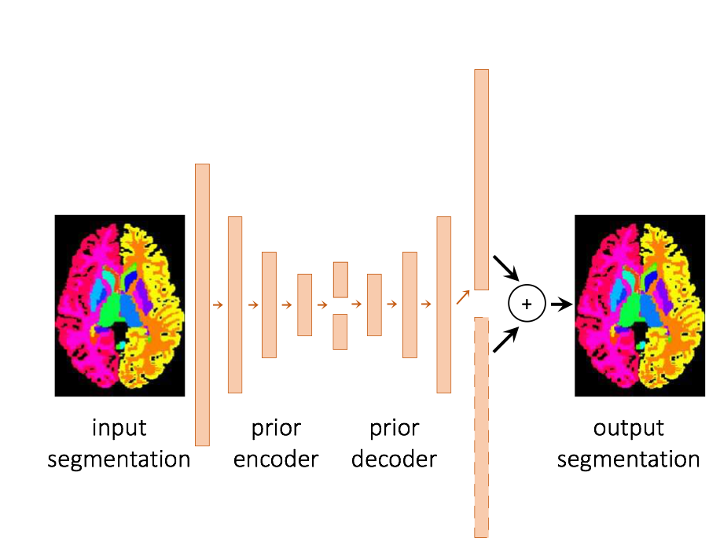
Model Structure
Stage 1
Auto-Encoding Anatomical Prior

Slide 5
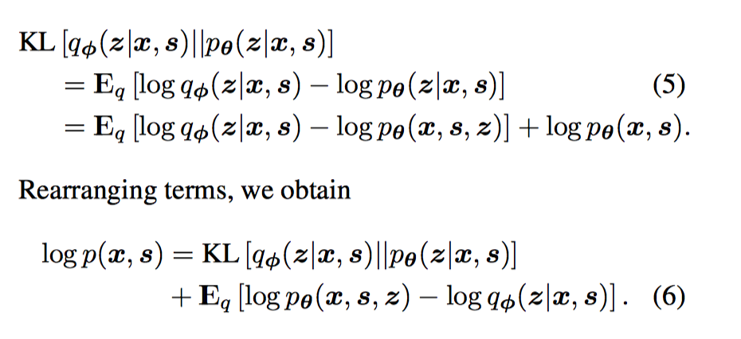
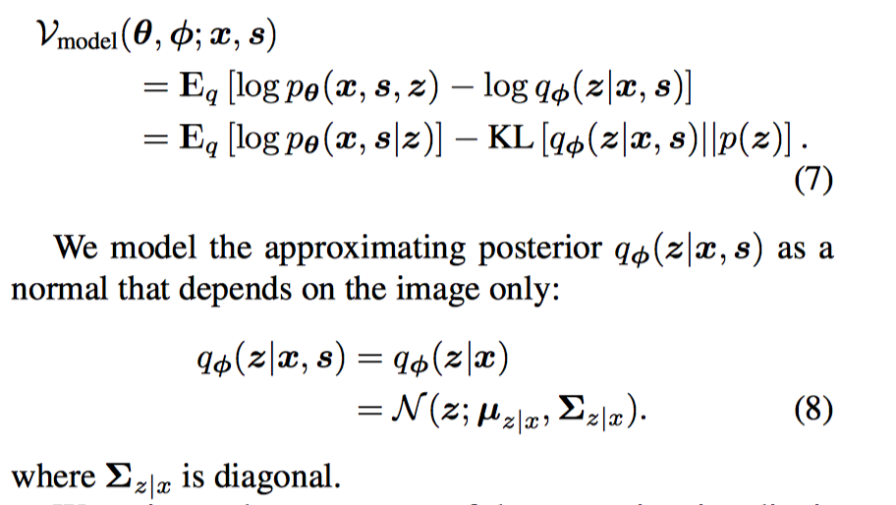
Model
Find likelihood of joint (x,s)

Slide 6
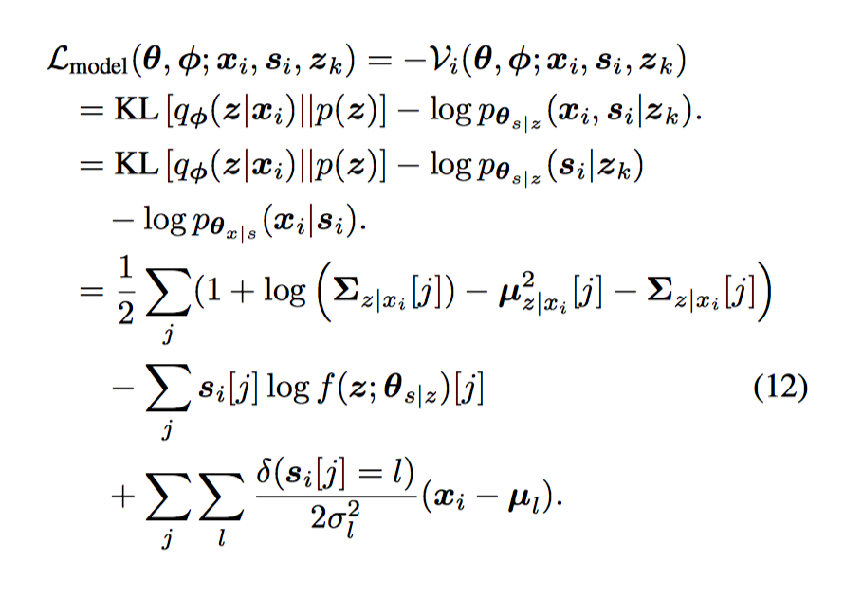
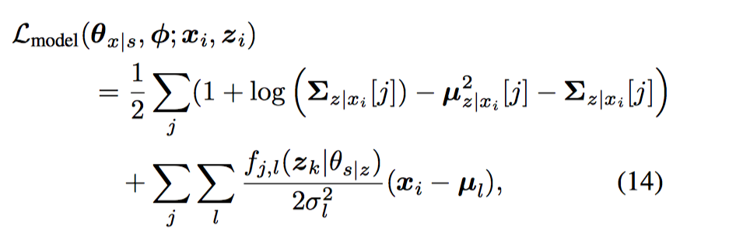
Model
Paired image loss
Unpaired image loss

Slide 7
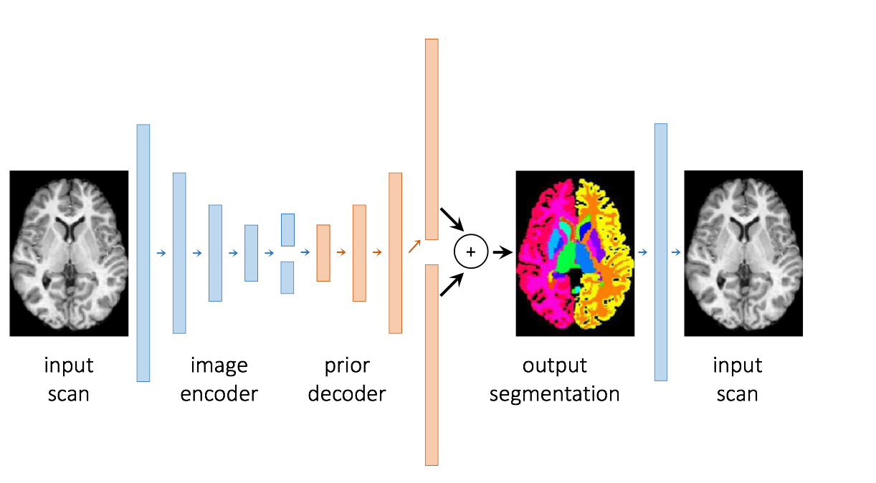



Model Structure
Stage 2
Unsupervised learning

Slide 8
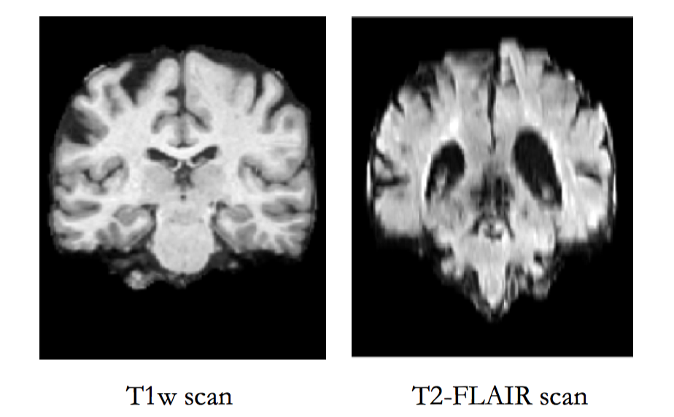
Dataset
1.T1w scan dataset
14,000 T1-weighted brain MRI scans from eight publicly available datasets.
5000 images for prior annotation training
some QCed segmentations were used for validation.
resampled to a 256x256x256
crop tp160x192x224
2. T2-FLAIR scan
3800 T2-FLAIR scans, a signiﬁcantly different MR modality
Image quality

Slide 9
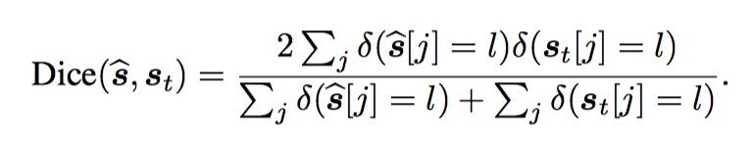
Experiment
1.Implement: Standard U-net
2.Evalution

Slide 10
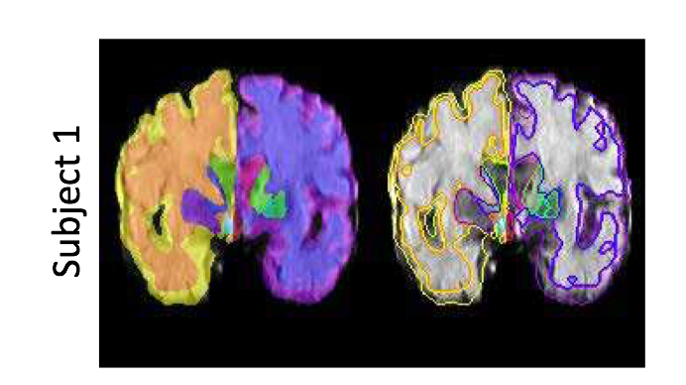
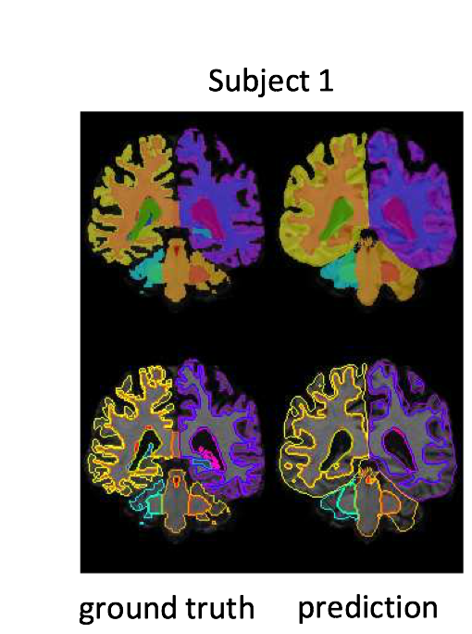
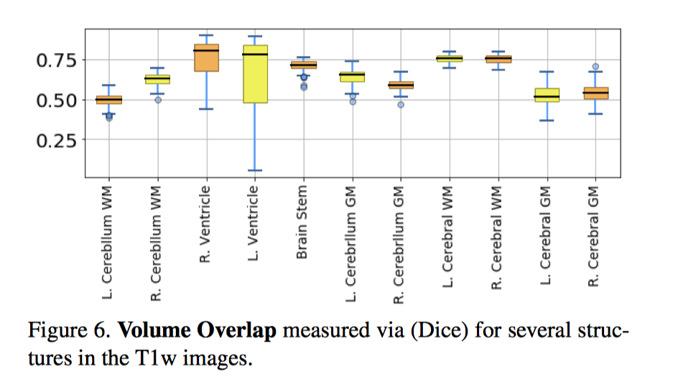
Experiment
3.Results
T2
T1

Slide 11
Thank you !
Welcome questions.

